Slide 1

SAP Build Training for Corporate Professionals
DAY-17
www.anubhavtrainings.com

Slide 2


DISCLAIMER
The training content and delivery of this presentation is confidential, and cannot be recorded, or copied and distributed to any third party, without the written consent of Anubhav Trainings

Slide 3
Agenda
Accessing SAP S/4HANA System
Introduction to Cloud Connector
SAP Standard API
Scenario Process visibility

Slide 4

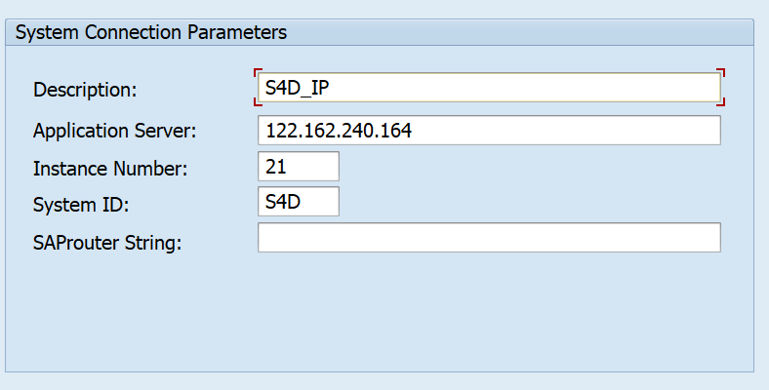
SAP Server Access
System Details
103.207.171.202
21
S4D

Slide 5
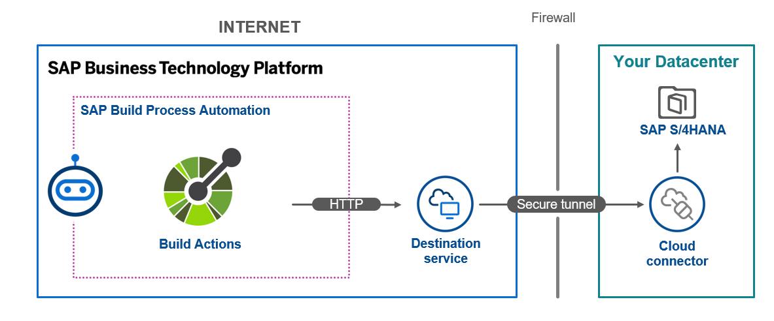
SAP Cloud Connector

Slide 6
Study material
sap.processautomation.enabled = true
Explore the SAP provided standard APIs
https://api.sap.com/package/S4HANAOPAPI/odata
https://api.sap.com/api/OP_API_SALES_ORDER_SRV_0001/overview
https://api.sap.com/api/OP_API_PRODUCT_SRV_0001/overview
Tcodes in S/4HANA
SMICM – to check the port numbers
/n/IWFND/MAINT_SERVICE – to check the available registered APIs
http://stsrvr.mynetgear.com:8021/sap/opu/odata/sap/API_SALES_ORDER_SRV/A_SalesOrder('309')?$format=json&$expand=to_Item
http://stsrvr.mynetgear.com:8021/sap/opu/odata/sap/API_PRODUCT_SRV/A_Product?$top=20&$filter=ProductType%20eq%20%27FERT%27&$expand=to_Description&$select=Product,to_Description/ProductDescription&$format=json

Slide 7
Steps
Go to https://api.sap.com
Open S/4HANA product
Search the particular APIs
Download the API specification
Check if these services are active or not, if not activate them
Test the apis in local browser and ensure what are all the filters, selections, conditions and data we want to select

Slide 8
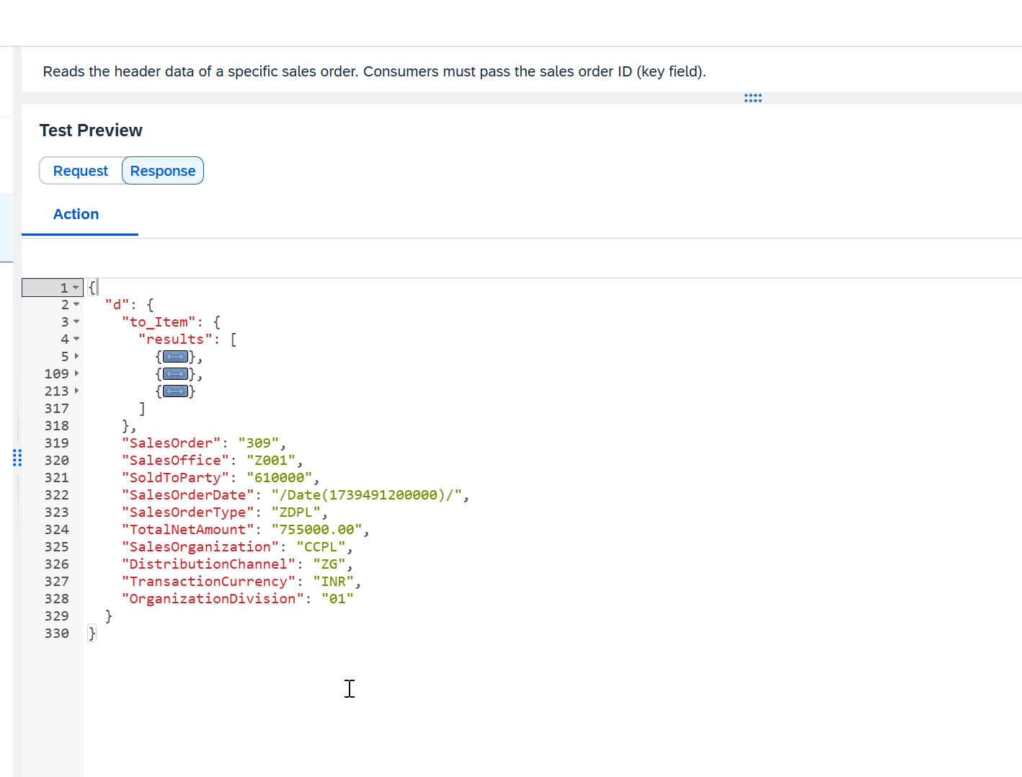
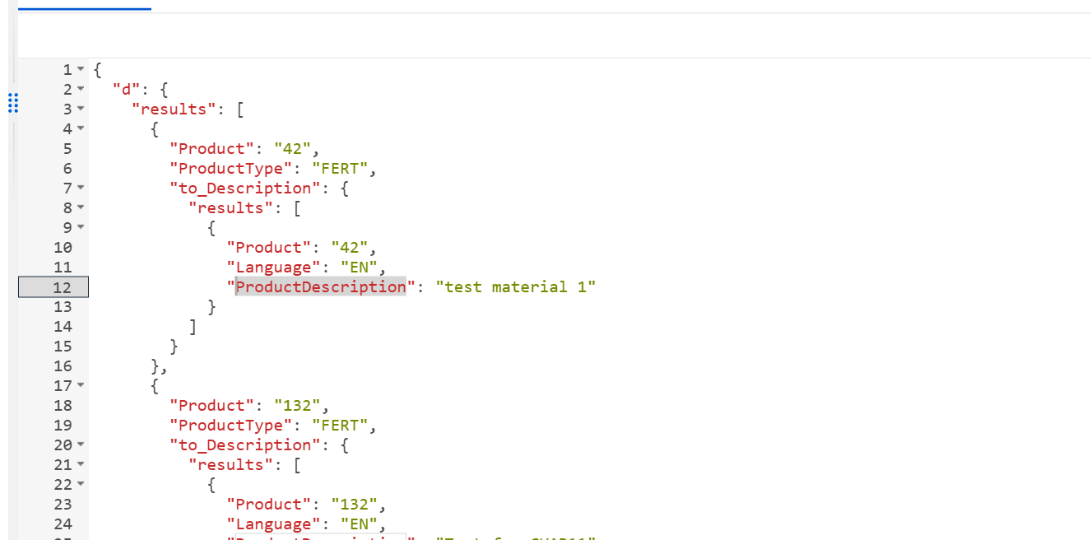
Output of actions
<content>

Slide 9






Scenario – Extract SAP S/4HANA Sales order
Citizen Developer
Design and deploy the build business process with process visibility scenario
Sales Representative
Starts the sales order process by providing order no. for approval
Sales Manager
Provides the necessary approval for the sales order
Sales Head
Track the progress of business process and KPIs (transparency)
SAP Build process Automation
SAP Build work zone
Build process
Process Trigger
My Inbox App
Visibility Scenario Dashboard
Requirement
Start the process with order no
Retrieve the order details from S4
Determine the approver based on Sales organization
Allows monitoring of process through key KPIs
orders

Slide 10
Process Visibility
The process visibility capability within the SAP Workflow Management service provides end-to-end visibility and intelligence to processes, which run on cloud, on-premise, and in hybrid environments.
The Process Visibility capability provides visibility on business processes with their extensions to enable process excellence by:
Providing a real-time view of an entire process regardless of the platform it operates on.
Providing actionable insights to steer the process forward.
Providing performance indicators for a business process to understand the current and the past performance.
The capability provides Process Workspace to track processes in real-time, search and filter instances, analyze performance indicators, and view detailed information about an instance.
https://help.sap.com/docs/process-visibility/process-visibility-capability/creating-visibility-scenario
http://s4dev.st.com:8021/sap/opu/odata/sap/API_SALES_ORDER_SRV/A_SalesOrder?$format=json&$filter=TotalNetAmount%20gt%2010000&$select=SalesOrder,SalesOrganization,TotalNetAmount

Slide 11

What We Did
Let’s Summarize
www.anubhavtrainings.com

Slide 12
www.anubhavtrainings.com
Thank You
End of Day 17
www.anubhavtrainings.com

Slide 13



We’re committed to empower you to be
#FutureReady
through powerful training solutions.
We build the workforce of the future.
250+
Corporate Clients
30,000+
Learners Trained
25000+
Learners Placed
FREE WEBINARS
Sign up for free webinars with industry experts every fortnight!
Enroll Now!
Contact us today!
https://anubhavtrainings.com

